Slide 1
Computer Graphics And Multimedia Systems SCS1302
Unit 1

Slide 2
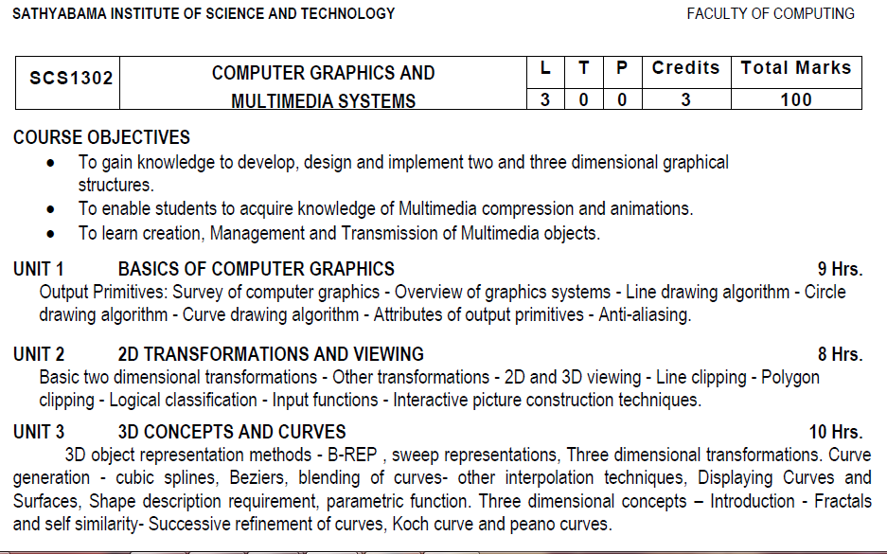
Syllabus

Slide 3
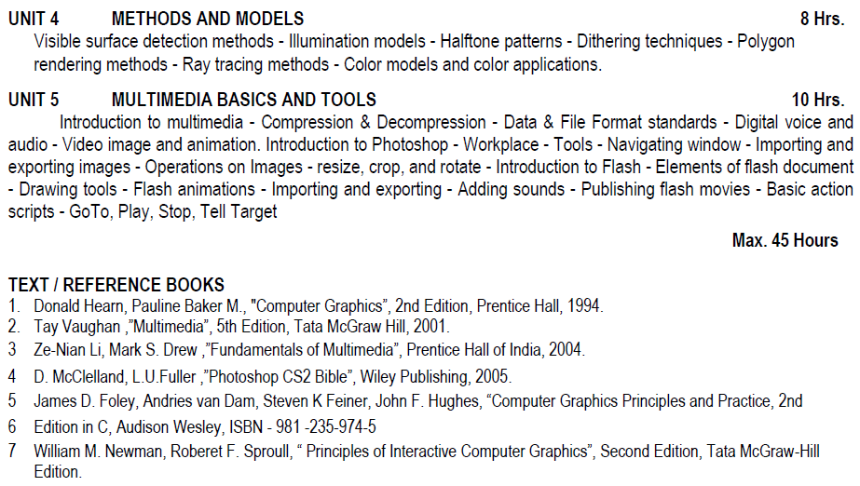
Syllabus

Slide 4
Course Objective(CO)
CO1: Construct lines and circles for the given input.
CO2: Apply 2D transformation techniques to transform the shapes to fit them as per the picture definition.
CO3: Construct splines, curves and perform 3D transformations
CO4: Apply colour and transformation techniques for various applications.
CO5: Analyse the fundamentals of animation, virtual reality, and underlying technologies.
CO6: Develop photo shop applications

Slide 5
Computer Graphics
Graphics - Plot some Points on graph
Computer Graphics - plot some pixels/points on computer screen to make image.
Algorithms & Data structures are used to draw images.
Computer Graphics involves creation, display, manipulation and storage of pictures and experimental data/models or images for proper visualization using a computer.
Such models come from diverse and expanding set of fields including physical, biological, mathematical, artistic, and conceptual/abstract structures.

Slide 6
Computer Graphics
Made up of 4 components:
1. Image – combinations of pixels, visual representation
2. Models – 3D representation
3. Rendering – generate image from 2D/3D model using
Computer Programs
4. Animation – Illusive movements
Graphics is an art of drawing using computer programs.
What we will draw?
Lines, Circles, curves, etc

Slide 7
Applications of CG
Computer-Aided Design(CAD)
Designing of buildings (Interior), automobiles, aircraft, computer..etc (Car -> sample/Prototype models )
Presentation Graphics
Commonly used to summarize financial, statistical, mathematical and economic data for research. (charts, business presentations)
Computer Art
Cartoons, Animated movies
Entertainment – Games, Cinema
Education and Training – Medical, Engg,Animation, Simulation
Visualization – Scientific, Medical(MRI), Gene Modeling
Image Processing
Virtual Reality
Graphical User Interface - Buttons, Mobile Apps, Menus
Architecture – Building design, lightening effects, maps, sewage design plans.

Slide 8
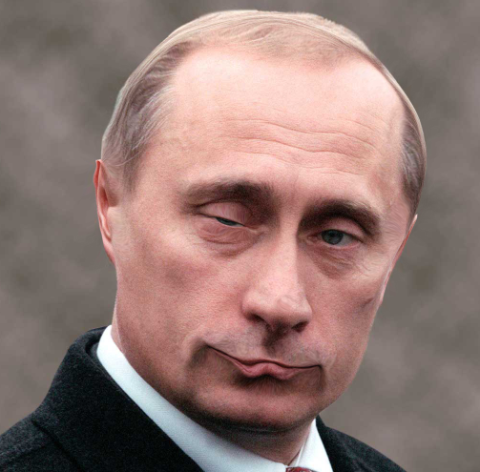
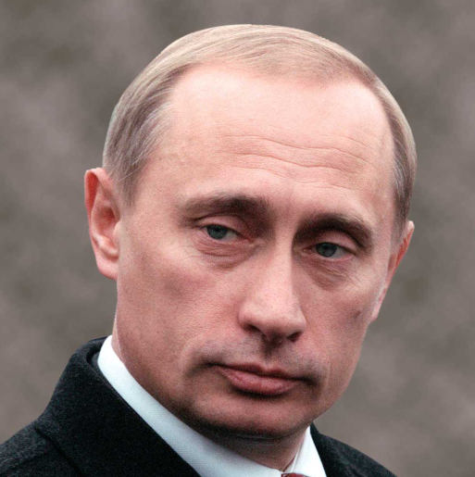
MORPH A PERSON’S FACE

Slide 9
Adobe Photoshop
Open the image you want to modify
Use the Liquify ( Filter → Liquify or press Shift + Ctrl + X )
Use various tools on the Liquify window to alter the person’s face. The various available tools are Warp Tool Wave Tool Swirl Tool Shrink Tool Expand Tool Move Left Tool Mirror Tool Undo Tool

Slide 10
Fundamental Terminologies
Image - From a geometry point of view, you can consider the image as a set of points on 2-d or 3-d space. Each point at every (x,y) is called amplitude or intensity of an image
Pixel - a pixel is the smallest , controllable element of a picture represented on the screen.
Resolution – Number of pixels in a computer screen.
Aspect Ratio- The aspect ratio of an image is the ratio of its width to its height necessary to produce equal-length lines in both directions on the screen. For an x: y aspect ratio, the image is x units wide and y units high.

Slide 11
Components of a computer graphics system
Typical graphics system comprises of a host computer with support of fast processor, large memory, frame buffer
Display devices (color monitors)
Input devices (mouse, keyboard, joystick, touch screen, trackball)
Output devices (CRT,LED,LCD panels, raster scan display, laser printers, color printers. Plotters etc.)
Interfacing devices such as, video I/O, TV interface etc.

Slide 12
Video Display devices
Cathode Ray Tube (CRT)
The primary output device in a graphical system is the video monitor. The main element of a video monitor is the Cathode Ray Tube
The CRT is a vacuum tube containing an electron gun(a source of electron) and fluorescent screen, with internal or external means to accelerate and deflect the electron beam, used to create images in the form of light emitted from the fluorescent screen. The image may be electrical waveforms, pictures (television , computer monitor),radar target and others.

Slide 13
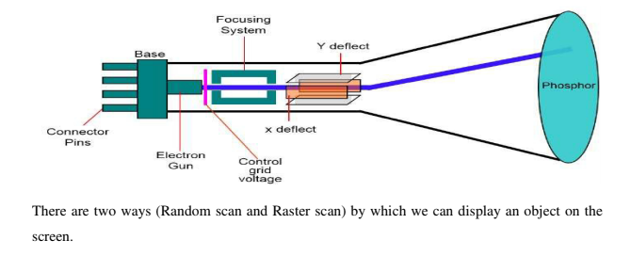
Video Display devices

Slide 14
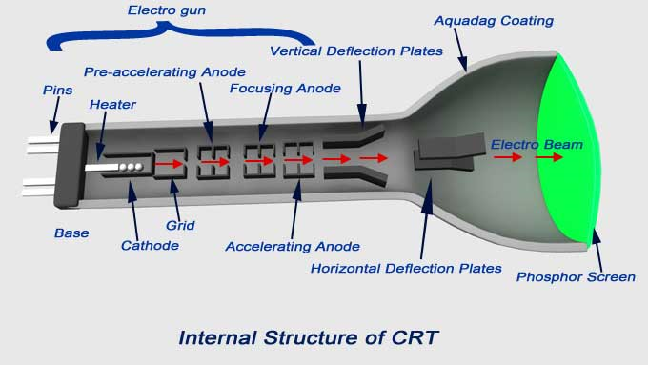

Slide 15
Main Parts of CRT:
Electron Gun assembly
Deflection plate assembly
Fluorescent screen
Glass envelope
Base through connection are made to various parts

Slide 16
The operation of CRT
The electron gun emits a beam of electrons (cathode rays), when the filament is heated.
Intensity of the electron beam is controlled by setting voltage levels on the control grid.
The focusing system is needed to force he electron beam to converge into a small spot as it strikes the phosphor screen, else the beam would spread out as it approaches the screen.
The electron beam passes through focusing and deflection systems that directs it towards specified positions on the phosphor-coated screen.

Slide 17
The operation of CRT
When the beam hits the screen, the phosphor emits a small spot of light at each position contacted by the electron beam.
It redraws the picture by directing the electron beam back over the same screen points quickly. This is called refreshing, hence the CRT is called as Refresh CRT.
The difference between the kinds of phosphors is their persistence- how long they continue to emit light after the CRT beam is removed.

Slide 18
Raster Scan
In a raster scan system, the electron beam is swept across the screen, one row at a time from top to bottom.
As the electron beam moves across each row, the beam intensity is turned on and off to create a pattern of illuminated spots.
Picture definition is stored in memory area called the Refresh Buffer or Frame Buffer.
Each screen point is referred to as a pixel (picture element) or pel.
At the end of each scan line,
the electron beam returns to the left side of the screen to begin displaying the next scan line.

Slide 19
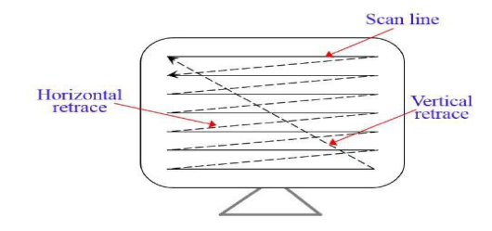
Raster Scan

Slide 20
Random Scan (Vector Scan)
In this technique, the electron beam is directed only to the part of the screen where the picture is to be drawn rather than scanning from left to right and top to bottom as in raster scan.
It is also called vector display, stroke-writing display, or calligraphic display.

Slide 21
Random Scan (Vector Scan)
Picture definition is stored as a set of line-drawing commands in an area of memory referred to as the refresh display file.
To display a specified picture, the system cycles through the set of commands in the display file, drawing each component line in turn.
After all the line-drawing commands are processed, the system cycles back to the first line command in the list.
Random-scan displays are designed to draw all the component lines of a picture 30 to 60 times each second.

Slide 22
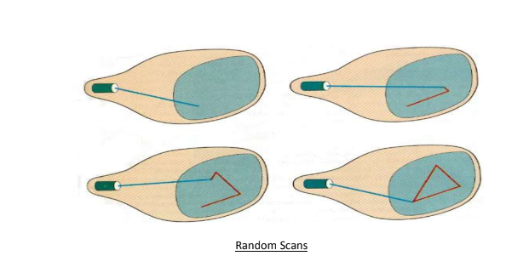
Random Scan (Vector Scan)

Slide 23
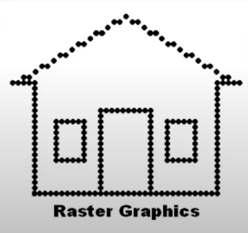
Pros and Cons
Raster Systems
Pros
It is well suited for realistic display of scenes containing colors and shaded patterns.
Cons
It produces jagged lines that are plotted as discrete point sets.

Slide 24
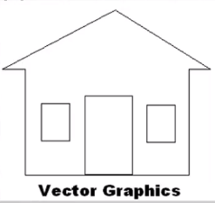
Pros and Cons
Random System(Vector)
Pros
They produce smooth line drawing because the CRT beam directly follows the line path
Used by both analog and digital computer.
It will have higher resolution rather than raster.
Cons
Expensive
Designed for line drawing applications
and cannot display realistic
shaded scenes.

Slide 25
Color CRT Monitor
A CRT monitor displays color picture by using a combination of phosphor that emit different-colored light.
By combining the emitted light from the different phosphor, a range of colors can be generated.

Slide 26
Color CRT Monitor
Two basic techniques – Beam Penetration and Shadow Masking
Beam-penetration method
The beam-penetration method for displaying color pictures has been used with random-scan monitors.
Two layers of phosphor, usually red and green, are coated onto the inside of the CRT screen, and the displayed color depends on how far the electron beam penetrates into the phosphor layers.

Slide 27
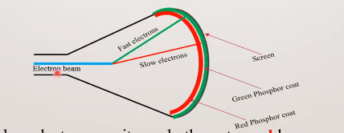
Color CRT Monitor
A beam of slow electrons excites only the outer red layer. A beam of very fast electron penetrates through the red layer and excites the inner green layer
At intermediate beam speeds, combinations of red and green light are emitted to show two additional colors, orange and yellow
The speed of the electrons, and hence the screen color at any point, is controlled by the beam-acceleration voltage

Slide 28
Color CRT Monitor
Shadow Mask Method
- Shadow-mask methods are commonly used in raster-scan system (including color TV)
A shadow-mask CRT has three phosphor color dots at each pixel position
One phosphor dot emits a red light, another emits a green light, and the third emits a blue light
It has three electron guns , one for Red , one for Green and one for Blue
A shadow mask behind the phosphorous coated screen

Slide 29
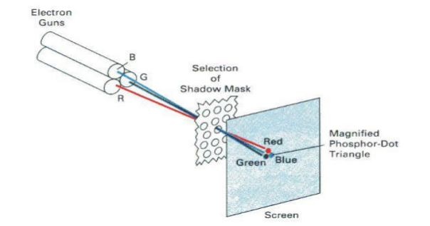
Shadow Mask Method

Slide 30
Shadow Mask Method
The three beams are deflected and focused as a group onto the shadow mask which contains a series of hall aligned with the phosphorous dots
When the three beams pass through a hole in the shadow mask, they activate a dot triangle
which appears as a small color spot on the screen
The phosphor dots in the triangles are arranged so that each electron beam can activate only its corresponding color dot when it passes through the shadow mask

Slide 31
Shadow Mask Method
We obtain color variations in a shadow-mask CRT by varying the intensity levels of the three electron beams
The color we see depends on the amount of excitation of the red, green, and blue phosphors.
A white or gray area is the result of exciting the three dots with equal intensity
Yellow is produced with the green and red dots only
Magenta is produced with the blue and red dots
Cyan shows up when blue and green are activated equally

Slide 32
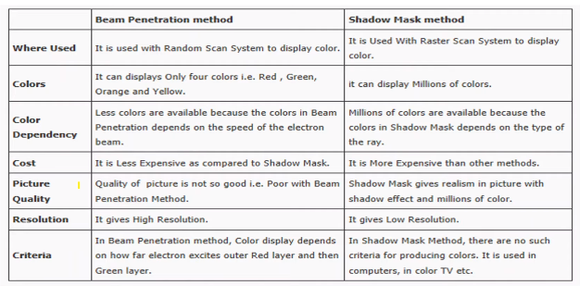
Comparison Between Beam Penetration method and Shadow Mask Method

Slide 33
Direct – View Storage Tubes (DVST)
The DVST gives the alternative method of maintaining the screen image
A DVST uses the storage grid which stores the picture information as a charge distribution just behind the phosphor coated screen

Slide 34
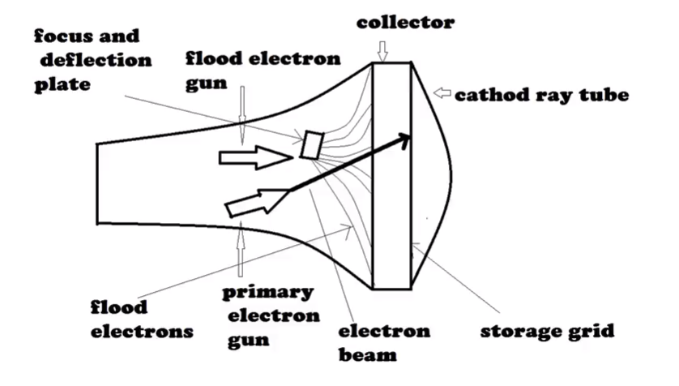
Direct – View Storage Tubes (DVST)

Slide 35
DVST
Advantages:
Refreshing of CRT is not required.
•Because no refreshing is required, very complex pictures can be displayed at very high resolution without flicker.
• It has flat screen.

Slide 36
DVST
Disdvantages:
They do not display colors and are available with single level of line intensity.
Selective or part erasing of screen is not possible.
Erasing of screen produces unpleasant flash over the entire screen surface which prevents its use of dynamics graphics applications.
It has poor contrast as a result of the comparatively low accelerating potential applied to the flood electrons.
The Performance of DVST is somewhat inferior to the refresh CRT.

Slide 37
Flat Panel Displays
The term Flat panel displays refers to a class of video devices that have reduced volume, weight and power requirements compared to a CRT.
The important feature of flat panel display is that they are thinner than the CRTs.
There are 2 types of flat panel displays
- Emissive Displays
- Non Emissive Displays

Slide 38
Flat Panel Displays
Emissive Displays – They convert electrical energy into light energies
E.g: Plasma Panels, LEDs
Non Emissive Displays - They use optical effects to convert sunlight or light from some other source into graphics patterns. E.g. LCD (Liquid Crystal Display)

Slide 39
Non emissive-LCD
LCD (Liquid Crystal Display) are commonly used in small systems such as calculators and portable computers
These non emissive devices produce a picture by passing polarized light from the surroundings or from an internal light source through a liquid-Crystal material that can be aligned to either block or transmit the light
Two glass plates each containing a light polarizer at right angles to the -other plate, sandwich the liquid crystal material.
Rows of horizontal transparent conductors are built into one glass plate, and columns of vertical conductors are put into the other plate.
The intersection of two conductors defines a pixel position.

Slide 40
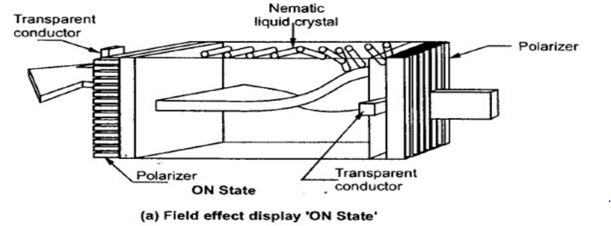
‘ON’ state of liquid crystals
Polarized light passing through the material is twisted so that it will pass through the opposite polarizer. The light is then reflected back to the viewer

Slide 41
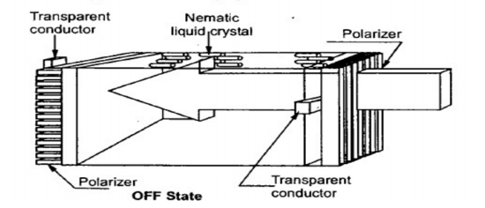
‘OFF’ state of liquid crystals
To turn off off the pixel we apply a voltage to the two intersecting conductors to align the molecules so that the light is not .twisted

Slide 42
Emissive-Plasma panels
Plasma panels- also called gas-discharge displays, are constructed by filling the region between two glass plates with a mixture of gases that usually includes neon .
A series of vertical conducting ribbons is placed on one glass panel, and a set of horizontal ribbons in other glass panel . Firing voltages applied to a pair of horizontal and vertical conductors cause the gas at the intersection of the two conductors to break down into a glowing plasma of electrons and ions.

Slide 43
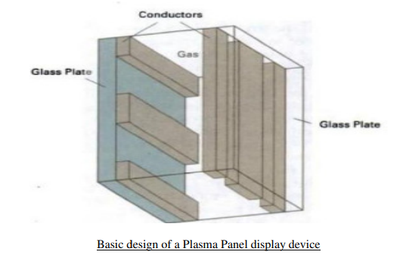
Plasma panels

Slide 44
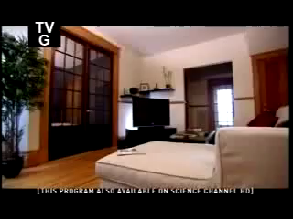
Plasma panels

Slide 45
Thin-film electroluminescent displays
They are similar to plasma panels except the region between glass panel is filled with phosphor
When a sufficiently high voltage is applied to a pair of crossing electrodes phosphor become a conductor in that area of intersection of electrodes
Electrical energy is absorbed by the atoms which then release this energy as a spot of light
Electroluminescent display requires more power than plasma panels

Slide 46
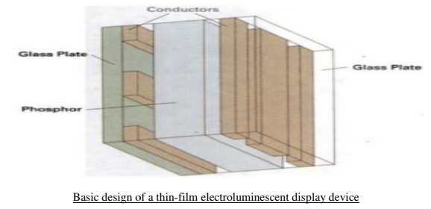
Thin-film electroluminescent displays

Slide 47
INPUT DEVICES
Keyboards, Button Boxes, and Dials
Mouse Devices
Trackball, Space ball
Joystick
Data Gloves
Digitizers
Image Scanners
Touch Panels
Light Pens
• Voice Systems

Slide 48
OUTPUT DEVICES
Printers
Plotters

